Slide 1
Pipelining
Control Hazards and Deeper pipelines
Notes:
Please if anyone has additional comments please speak up

Slide 2
Four Branch Hazard Alternatives
#1: Stall until branch direction is clear
#2: Predict Branch Not Taken
  Execute successor instructions in sequence
  “Squash” instructions in pipeline if branch actually taken
  Advantage of late pipeline state update
  47% MIPS branches not taken on average
  PC+4 already calculated, so use it to get next instruction
#3: Predict Branch Taken
  53% MIPS branches taken on average
  But haven’t calculated branch target address in MIPS
    MIPS still incurs 1 cycle branch penalty
    Other machines: branch target known before outcome

Slide 3
Four Branch Hazard Alternatives
#4: Delayed Branch (Compiler help)
  Define branch to take place AFTER a following instruction
  branch instruction
  sequential successor₁
  sequential successor₂
  ........
  sequential successor_{n}
  branch target if taken
  1 slot delay allows proper decision and branch target address in 5 stage pipeline
  MIPS uses this
Branch delay of length n

Slide 4
Reduction of Branch Penalties:
Delayed Branch
When delayed branch is used, the branch is delayed by n cycles, following this execution pattern:
conditional branch instruction
sequential successor₁
sequential successor₂
……..
sequential successor_{n}
branch target if taken
The sequential successor instruction are said to be in the branch delay slots. These instructions are executed whether or not the branch is taken.

Slide 5
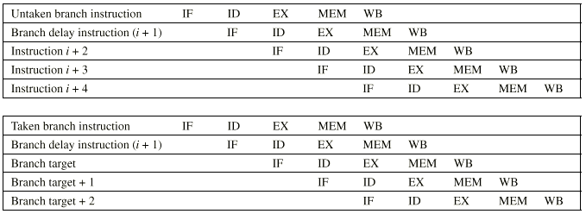
Delayed Branch Example

Slide 6
Reduction of Branch Penalties:
Delayed Branch
In Practice, all machines that utilize delayed branching have a single instruction delay slot.
The job of the compiler is to make the successor instructions valid and useful instructions.
  Fills about 60% of branch delay slots
  About 80% of instructions executed in branch delay slots useful in computation
  About 50% (60% x 80%) of slots usefully filled

Slide 7
Delayed Branch-delay Slot Scheduling Strategies
The branch-delay slot instruction can be chosen from three cases:
An independent instruction from before the branch:
Always improves performance when used. The branch
must not depend on the rescheduled instruction.
An instruction from the target of the branch:
Improves performance if the branch is taken and may require instruction duplication. This instruction must be safe to execute if the branch is not taken.
An instruction from the fall through instruction stream:
Improves performance when the branch is not taken. The instruction must be safe to execute when the branch is taken.

Slide 8
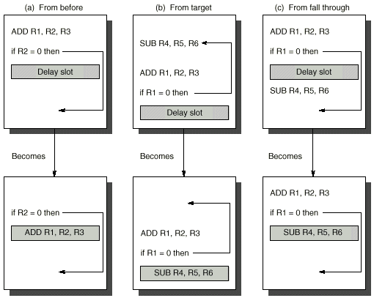
(A)
(B)
(C)

Slide 9
Delayed Branch
Instruction in branch delay slot is always executed
Compiler (tries to) move a useful instruction into delay slot.
From before the Branch: Always helpful when possible
ADD R1, R2, R3
BEQZ R2, L1 BEQZ R2, L1
DELAY SLOT ADD R1, R2, R3
- -
L1: L1:
If the ADD instruction were: ADD R2, R1, R3 the move would not be possible

Slide 10
Delayed Branch
(b) From the Target: Helps when branch is taken. May duplicate instructions
ADD R2, R1, R3 ADD R2, R1, R3
BEQZ R2, L1 BEQZ R2, L2
DELAY SLOT SUB R4, R5, R6
- -
L1: SUB R4, R5, R6 L1: SUB R4, R5, R6
L2: L2:
Instructions between BEQ and SUB (in fall through) must not use R4.

Slide 11
Delayed Branch
( c ) From Fall Through: Helps when branch is not taken.
ADD R2, R1, R3 ADD R2, R1, R3
BEQZ R2, L1 BEQZ R2, L1
DELAY SLOT SUB R4, R5, R6
SUB R4, R5, R6 -
-
L1: L1:
Instructions at target (L1 and after) must not use R4 till set again.
Cancelling (Nullifying) Branch:
  Branch instruction indicates direction of prediction.
  If mispredicted the instruction in the delay slot is cancelled.
  Greater flexibility for compiler to schedule instructions.

Slide 12
Branch-delay Slot: Canceling Branches
In a canceling branch, a static compiler branch direction prediction is included with the branch-delay slot instruction.
When the branch goes as predicted, the instruction in the branch delay slot is executed normally.
When the branch does not go as predicted the instruction is turned into a no-op.
Canceling branches eliminate the conditions on instruction selection in delay instruction strategies B, C
The effectiveness of this method depends on whether we predict the branch correctly.
In practice 50% of time, we have no stalls (nop).

Slide 13
Performance of Branch Schemes
The effective pipeline speedup with branch penalties: (assuming an ideal pipeline CPI of 1)
Pipeline speedup = Pipeline depth
1 + Pipeline stall cycles from branches
Pipeline stall cycles from branches = Branch frequency X branch penalty
Pipeline speedup = Pipeline Depth
1 + Branch frequency X Branch penalty

Slide 14
Evaluating Branch Alternatives
Scheduling Branch CPI speedup v. scheme penalty unpipelined
Stall pipeline 1 1.14 4.4
Predict taken 1 1.14 4.4
Predict not taken 1 1.09 4.5
Delayed branch 0.5 1.07 4.6
Conditional & Unconditional = 14%, 65% change PC (taken)

Slide 15
Delayed Branch
Limitations of delayed branch
  Compiler may not find appropriate instructions to fill delay slots. Then it fills delay slots with no-ops.
  Visible architectural feature – likely to change with new implementations
    Pipeline structure is exposed to compiler. Need to know how many delay slots.

Slide 16
Delayed Branch
Compiler effectiveness for single branch delay slot:
  Fills about 60% of branch delay slots
  About 80% of instructions executed in branch delay slots useful in computation
  About 50% (60% x 80%) of slots usefully filled
Delayed Branch downside: As processor go to deeper pipelines and multiple issue, the branch delay grows and need more than one delay slot
  Delayed branching has lost popularity compared to more expensive but more flexible dynamic approaches
  Growth in available transistors has made dynamic approaches relatively cheaper

Slide 17
Dynamic Branch Prediction
Builds on the premise that history matters
  Observe the behavior of branches in previous instances and try to predict future branch behavior
  Try to predict the outcome of a branch early on in order to avoid stalls
  Branch prediction is critical for multiple issue processors
    In an n-issue processor, branches will come n times faster than a single issue processor

Slide 18
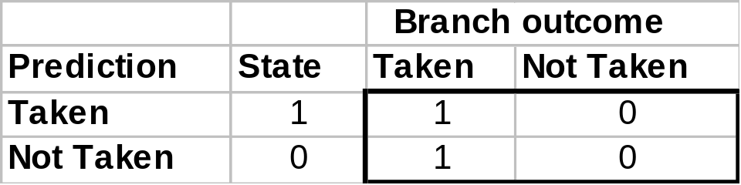
Basic Branch Predictor
Use a 1-bit branch predictor buffer or branch history table
1 bit of memory stating whether the branch was recently taken or not
Bit entry updated each time the branch instruction is executed
T
NT
NT
State 1
Predict
Taken
State 0
Predict
Not Taken
T

Slide 19
1-bit Branch Prediction Buffer
Problem – even simplest branches are mispredicted twice
LD R1, #5
Loop: LD R2, 0(R5)
ADD R2, R2, R4
STORE R2, 0(R5)
ADD R5, R5, #4
SUB R1, R1, #1
BNEZ R1, Loop
First time: prediction = 0
but the branch is taken ⇒ change
prediction to 1 miss
Time 2, 3, 4: prediction = 1
and the branch is taken
Time 5: prediction = 1
but the branch is not taken ⇒ change
prediction to 0 miss

Slide 20
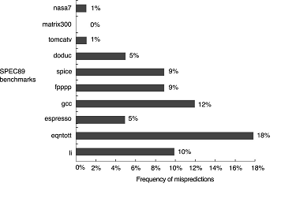
Dynamic Branch Prediction Accuracy

Slide 21
Deeper pipelines
Notes:
Please if anyone has additional comments please speak up

Slide 22
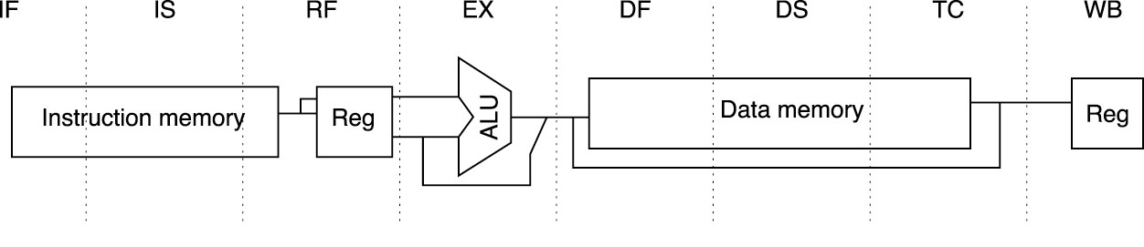
Superpipelining: MIPS R4000 Integer pipeline
8 Stage Pipeline:
  IF–first half of fetching of instruction; PC selection happens here as well as initiation of instruction cache access.
  IS–second half of access to instruction cache.
  RF–instruction decode and register fetch, hazard checking and also instruction cache hit detection.
Notes:
Answer is 3 stages between branch and new instruction fetch and 2 stages between load and use (even though if looked at red insertions that it would be 3 for load and 2 for branch)
Reasons:
1) Load: TC just does tag check, data available after DS; thus supply the data & forward it, restarting the pipeline on a data cache miss
2) EX phase does the address calculation even though just added one phase; presumed reason is that since want fast clockc cycle don’t want to sitck RF phase with reading regisers AND testing for zero, so just moved it back on phase

Slide 23
Superpipelining: MIPS R4000 Integer pipeline
8 Stage Pipeline:
  EX–execution, which includes effective address calculation, ALU operation, and branch target computation and condition evaluation.
  DF–data fetch, first half of access to data cache.
  DS–second half of access to data cache.
  TC–tag check, determine whether the data cache access hit.
  WB–write back for loads and register-register operations.
8 Stages: How many stalls occur due to load dependencies and control hazards?
Notes:
Answer is 3 stages between branch and new instruction fetch and 2 stages between load and use (even though if looked at red insertions that it would be 3 for load and 2 for branch)
Reasons:
1) Load: TC just does tag check, data available after DS; thus supply the data & forward it, restarting the pipeline on a data cache miss
2) EX phase does the address calculation even though just added one phase; presumed reason is that since want fast clockc cycle don’t want to sitck RF phase with reading regisers AND testing for zero, so just moved it back on phase

Slide 24
Stalls in MIPS R4000
TWO Cycle
Load Latency
IF
IS
IF
RF
IS
IF
EX
RF
IS
IF
DF
EX
RF
IS
IF
DS
DF
EX
RF
IS
IF
TC
DS
DF
EX
RF
IS
IF
WB
TC
DS
DF
EX
RF
IS
IF
THREE Cycle
Branch Latency
IF
IS
IF
RF
IS
IF
EX
RF
IS
IF
DF
EX
RF
IS
IF
DS
DF
EX
RF
IS
IF
TC
DS
DF
EX
RF
IS
IF
WB
TC
DS
DF
EX
RF
IS
IF
(conditions evaluated
during EX phase)
Delay slot plus two stalls
Branch likely cancels delay slot if not taken

Slide 25
Floating Point/Multicycle Pipelining in MIPS
Completion of MIPS EX stage floating point arithmetic operations in one or two cycles is impractical since it requires:
    A much longer CPU clock cycle, and/or
    An enormous amount of logic.
Instead, the floating-point pipeline will allow for a longer latency.
Floating-point operations have the same pipeline stages as the integer instructions with the following differences:
  The EX cycle may be repeated as many times as needed.
  There may be multiple floating-point functional units.
  A stall will occur if the instruction to be issued either causes a structural hazard for the functional unit or cause a data hazard.

Slide 26
Floating Point/Multicycle Pipelining in MIPS
The latency of functional units is defined as the number of intervening cycles between an instruction producing the result and the instruction that uses the result (usually equals stall cycles with forwarding used).
The initiation or repeat interval is the number of cycles that must elapse between issuing an instruction of a given type.

Slide 27
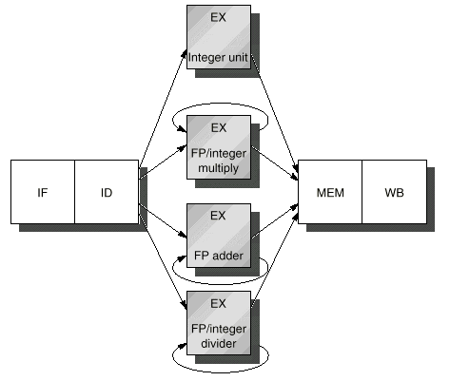
Extending The MIPS Pipeline
to Handle Floating-Point
Operations:
Adding Non-Pipelined
Floating Point Units
(In Appendix A)

Slide 28
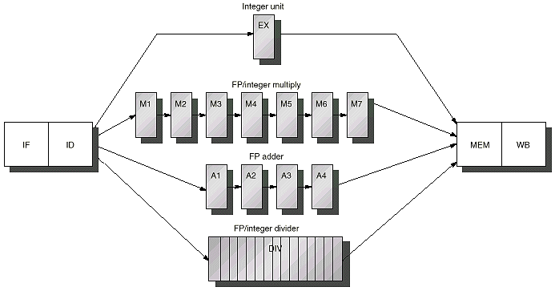
Extending The MIPS Pipeline:
Multiple Outstanding Floating Point Operations
Latency = 6
Initiation Interval = 1
Pipelined
Integer Unit
Latency = 0
Initiation Interval = 1
Hazards:
RAW, WAW possible
WAR Not Possible
Structural: Possible
Control: Possible
Floating Point (FP)/Integer Multiply
IF
ID
EX
MEM
WB
FP Adder
Latency = 3
Initiation Interval = 1
Pipelined
FP/Integer Divider
Latency = 24
Initiation Interval = 25
Non-pipelined

Slide 29
Latencies and Initiation Intervals For
Functional Units
Functional Unit Latency Initiation Interval
Integer ALU 0 1
Data Memory 1 1
(Integer and FP Loads)
FP add 3 1
FP multiply 6 1
(also integer multiply)
FP divide 24 25
(also integer divide)
Latency usually equals stall cycles when full forwarding is used

Slide 30
Pipeline Characteristics With FP
Instructions are still processed in-order in IF, ID, EX at the rate of instruction per cycle.
Longer RAW hazard stalls likely due to long FP latencies.
Structural hazards possible due to varying instruction times and FP latencies:
  FP unit may not be available; divide in this case.
  MEM, WB reached by several instructions simultaneously.
WAW hazards can occur since it is possible for instructions to reach WB out-of-order.
WAR hazards impossible, since register reads occur in-order in ID.
Instructions are allowed to complete out-of-order requiring special measures to enforce precise exceptions.

Slide 31
FP Operations Pipeline Timing Example
CC 1
CC 2
CC 3
CC 4
CC 5
CC 6
CC 7
CC 8
CC 9
CC 10
CC 11
MUL.D
IF
ID
M1
M2
M3
M4
M5
M6
M7
MEM
WB
ADD.D
IF
ID
A1
A2
A3
A4
MEM
WB
L.D
IF
ID
EX
MEM
WB
S.D
IF
ID
EX
MEM
WB
All above instructions are assumed independent

Slide 32
FP Code RAW Hazard Stalls Example
(with full data forwarding in place)
CC 1
CC 2
CC 3
CC 4
CC 5
CC 6
CC 7
CC 8
CC 9
CC 10
CC 11 CC12 CC13 CC14 CC15 CC16 CC17 CC18
L.D F4, 0(R2)
IF
ID
EX
MEM
WB
MUL.D F0, F4, F6
IF
ID
STALL
M1
M2
M3
M4
M5
M6
M7
MEM
WB
ADD.D F2, F0, F8
IF
STALL
ID
STALL
STALL
STALL
STALL
STALL
STALL
A1
A2
A3
A4
MEM
WB
S.D F2, 0(R2)
IF
STALL
STALL
STALL
STALL
STALL
STALL
ID
EX
STALL
STALL
STALL
MEM
WB
Third stall due
to structural hazard
in MEM stage
6 stall cycles which equals latency of FP add functional unit

Slide 33
Dealing with RAW
Longer latency pipes cause the frequency of RAW stalls to go up.
More complicated forwarding
Frequent compiler scheduling
More advanced techniques to be covered later

Slide 34
FP Code Structural Hazards Example
CC 1
CC 2
CC 3
CC 4
CC 5
CC 6
CC 7
CC 8
CC 9
CC 10
CC 11
MULTD F0, F4, F6
IF
ID
M1
M2
M3
M4
M5
M6
M7
MEM
WB
. . . (integer)
IF
ID
EX
MEM
WB
. . . (integer)
IF
ID
EX
MEM
WB
ADDD F2, F4, F6
IF
ID
A1
A2
A3
A4
MEM
WB
. . . (integer)
IF
ID
EX
MEM
WB
. . . (integer)
IF
ID
EX
MEM
WB
LD F2, 0(R2)
IF
ID
EX
MEM
WB

Slide 35
Dealing with Structural Hazards
Option 1: Track the use of the write port; stall instruction in ID if there is a collision.
  Maintain the property of stalling instruction only in ID.
  Extra HW (e.g., write conflict logic).
Option 2: Stall a conflict instruction at MEM entry.
  Flexible in choose a instruction to be stalled (give priority to the longest latency).
  Complicates pipeline control.

Slide 36
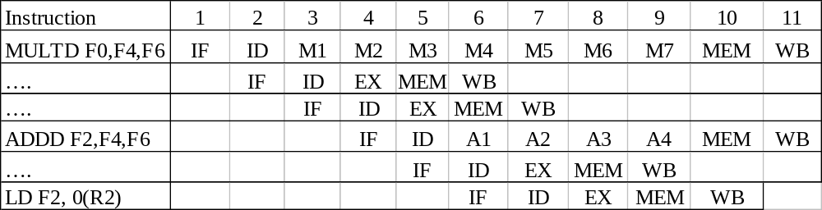
Dealing with WAW Hazards
WAW
Hazards
Option 1: Delay LD until ADDD enter MEM
Option 2: Stamp out the result of ADDD.

